Slide 1

Bora Kandemir & Batuhan Çevik
- Machine Learning End of Term Presentation -
- Dr.Öğr.Üy. MUSTAFA ÇAVUŞ -
Classification of the Energy Level of Songs
Convert the variable "energy" to a binary variable (if energy > 50 is 1)
Target is whether a song is energetic (energy > 50)
https://www.kaggle.com/datasets/nelgiriyewithana/top-spotify-songs-2023

Slide 2
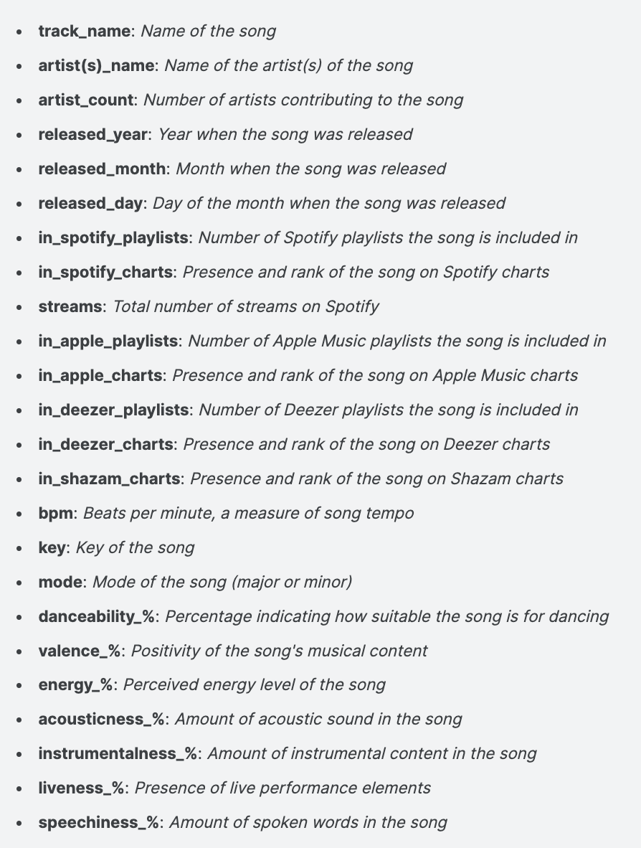

ABOUT DATASET :
This dataset contains a comprehensive list of the most famous songs of 2023 as listed on Spotify. The dataset offers a wealth of features beyond what is typically available in similar datasets. It provides insights into each song's attributes, popularity, and presence on various music platforms. The dataset includes information such as track name, artist(s) name, release date, Spotify playlists and charts, streaming statistics, Apple Music presence, Deezer presence, Shazam charts, and various audio features.
MOST STREAMED SPOTIFY SONGS 2023

Slide 3

Problem, Features and Target :
Analyzing and predicting the energy levels of songs based on the given data set. The dataset includes various features that provide information about songs. These features include danceability, valence, liveness etc. The target variable in this data set is whether the energy levels of the songs are greater than or less than 50.It is represented by the “energy_%” column, where 1 indicates the energy level of songs are equal or greater than 50 and 0 indicates its less than 50.
The Dataset :
The dataset includes 817 observations, 5 categorical variables and 19 numeric variables.

Slide 4
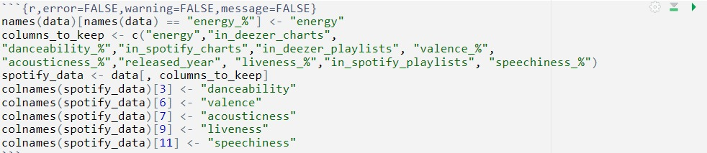

This R code block changes the column names in the data dataframe and then selects and renames specific columns to create a new dataframe. In summary, this code block selects certain columns from the data dataframe, changes the names of some columns, and results in the creation of a new dataframe named spotify_data.

Slide 5

For imbalanced problem, This code block balances the energy variable in the spotify_data dataset and addresses class imbalances within the dataset. This process ensures that the classes have an equal number of examples, which can improve the model’s training performance by balancing the dataset and setting randomness configurations.

Slide 6
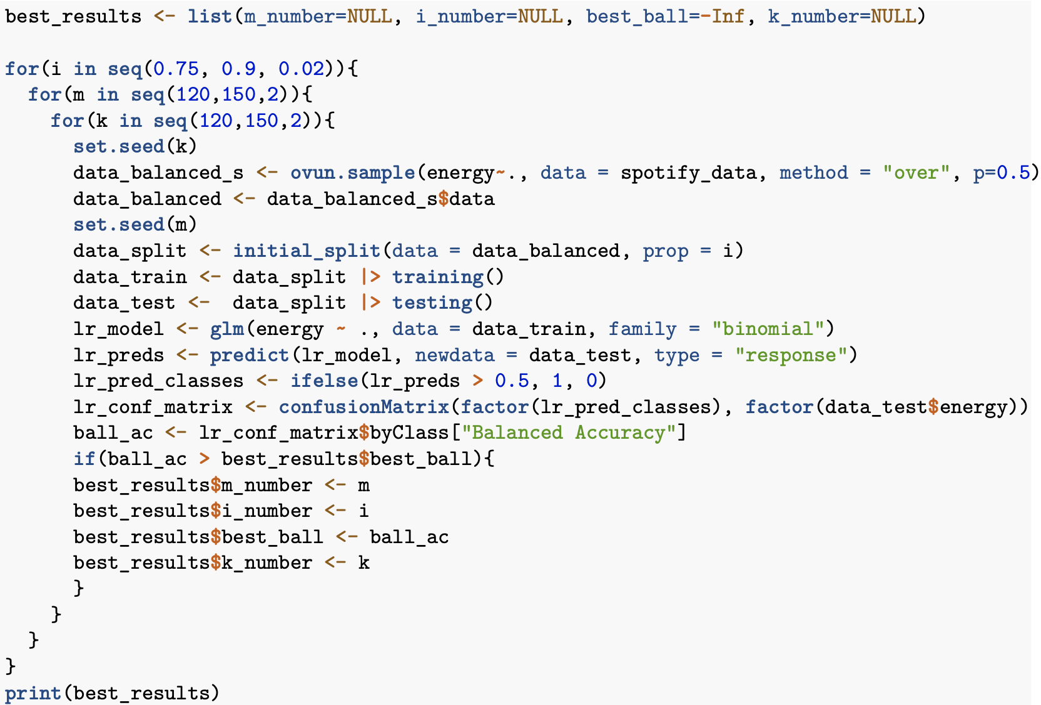
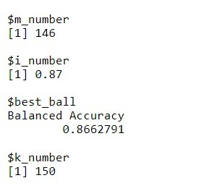
This R code block contains a loop that searches various parameters to get the best balanced accuracy using a logistic regression model on a dataset. To briefly summarize, the code block tries to find the best model by iterating over three parameters (i, m and k).

Slide 7
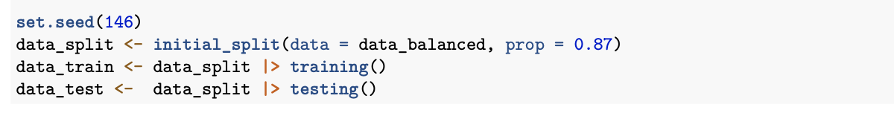

Splitting Edited Data
This code block randomly splits the balanced dataset into 87% training set and 13% test set.

Slide 8
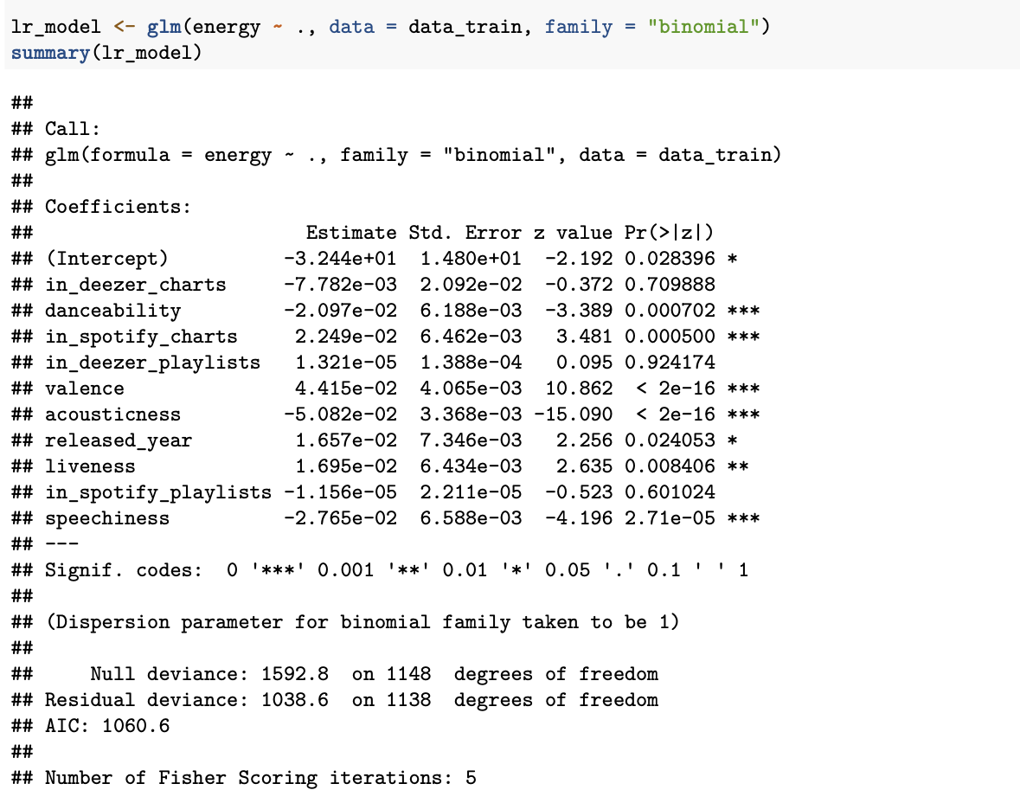
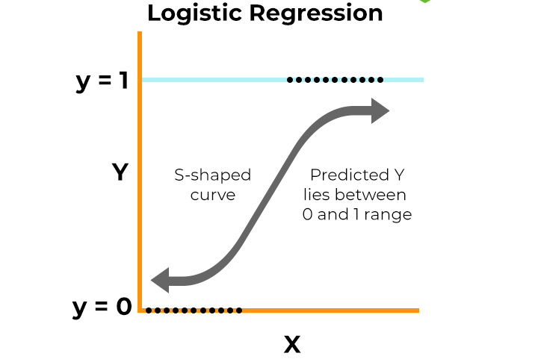
Logistic Regression Model and It’s Performance :
The difference between null and residual deviation values indicates that the model provides improvement. The AIC value is 1060.6. This value evaluates the fit of the model, while a lower AIC value will indicate that the model fits the data better. The Fisher Scoring iterations value is 5, indicating that the optimization process was repeated five times.

Slide 9
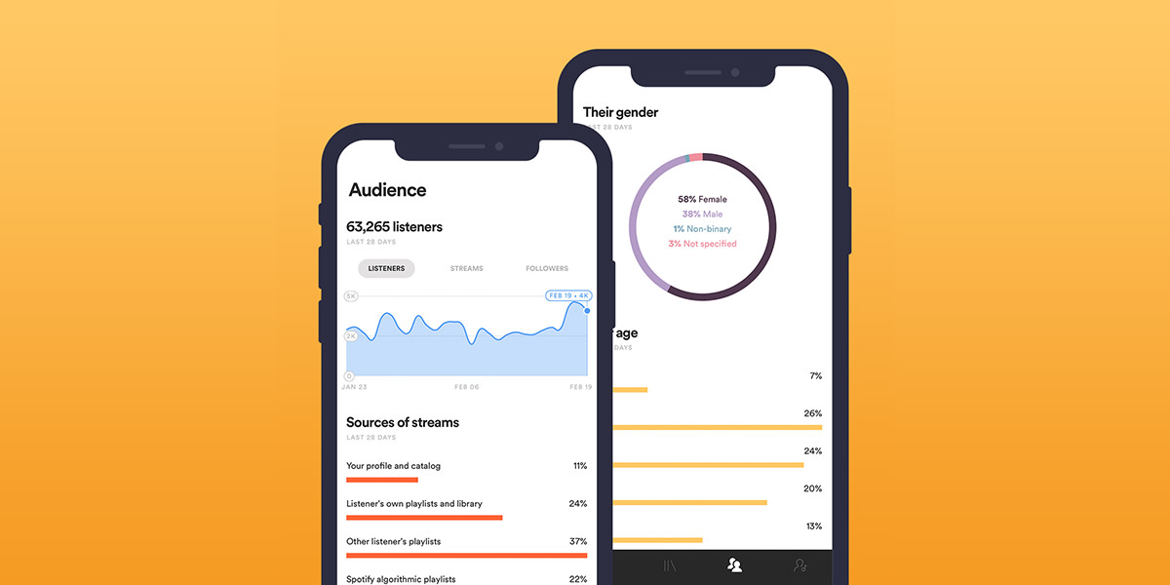
This R code block makes predictions on the test dataset using the logistic regression model and converts these predictions into binary classes. In summary, this block of code makes probability predictions on the test dataset using the created logistic regression model and then transforms these predictions into two classes, 0 and 1. This process is used to evaluate the classification performance of the model.

Slide 10
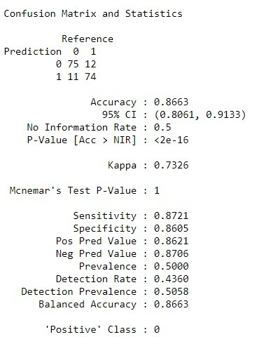
Accuracy: Shows the proportion of observations classified as correct. In this case, the accuracy rate is 0.8663, meaning the model has a high ability to predict correctly.
Sensitivity: Shows the proportion of true positives correctly classified. In this case, the precision ratio is 0.8721, meaning that the model’s ability to correctly identify positive cases is quite high.
Specificity: Shows the proportion of true negatives that are correctly classified. In this case, the specificity ratio is 0.8605, meaning the model’s ability to correctly identify negative situations is quite high.
Kappa Statistic: Measures how good the model is relative to its ability to make random predictions. A value close to 1 indicates that the model is much better than random guessing. Sensitivity (Detection Rate): Shows the detection rate of true positives. In this case, the detection rate is 0.4360, meaning only 43.60% of true positives were correctly detected.

Slide 11
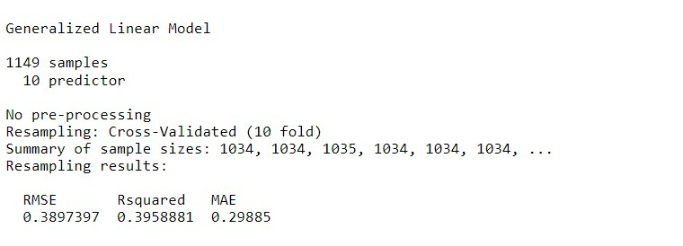
It shows that the obtained RMSE, R-squared and MAE values are quite low and there is no sign of overfitting.

Slide 12
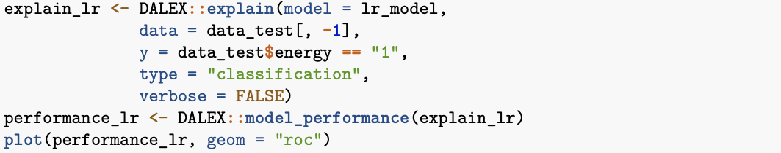
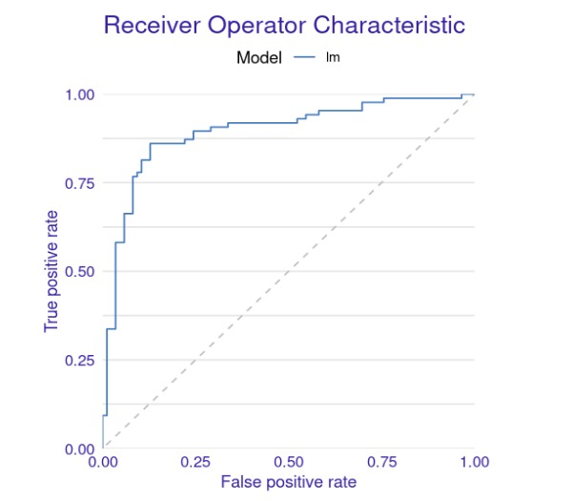
The ROC curve of the model lies well above the diagonal line, indicating that the model has a good ability to distinguish positive and negative classes. The model is able to maintain a low FPR while achieving a high TPR. This shows that the model is effective in distinguishing the two classes. Overall, the ROC curve shows that the model performs well in classifying samples and provides a good balance between sensitivity and specificity.

Slide 13
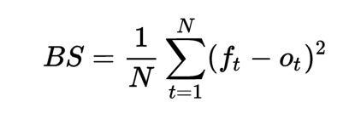
The Brier score is a measure that assesses how well the predictions of a model align with the true labels. In this particular case, the Brier score has been calculated as 0.1479531. A lower Brier score indicates that the model’s predictions are more in line with the true labels. Therefore, a Brier score of 0.1479531 suggests that the model’s predictions are generally acceptably good and indicative of alignment with the true labels.

Slide 14
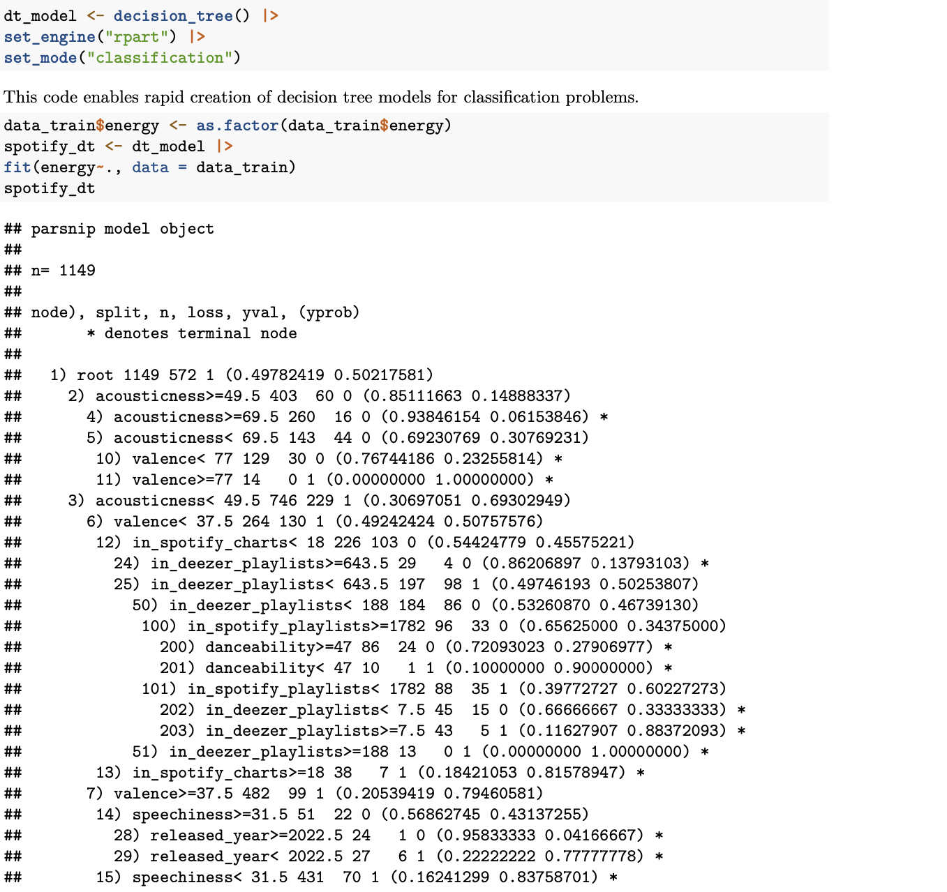
Decision Tree Model and It’s Performance :
This output describes the decision rule that the decision tree model uses to classify data samples based on certain characteristics. For example, it makes decisions based on properties such as acousticness,valence,danceability,in_spotify_charts,
in_deezer_playlists,released_year,and,speechlessness. Each decision point checks the value of an attribute and makes a decision based on a certain threshold value. For example, (acousticness>=49.5) checks whether the acousticness property is greater than or equal to 49.5. This determines which subcategory a data point will be assigned to. Ultimately, this output represents the complex decision processes of the model and shows the importance of features in the data set in the classification process.

Slide 15
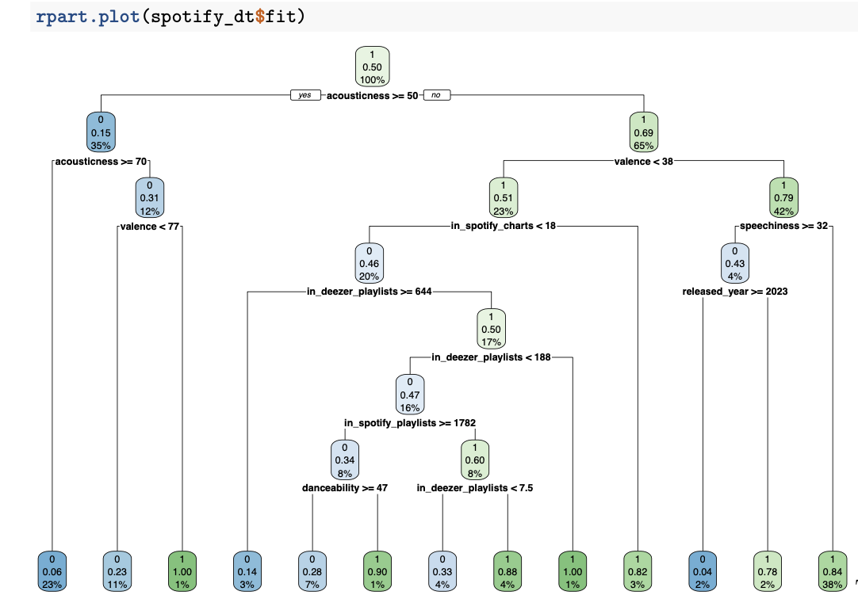

Root Node; acousticness <= 50: This is the first split point of the decision tree. If a song’s acoustic value is less than 50, right; If not, we go left. Left Branch; acousticness <= 70: If acousticness is greater than 50 and less than or equal to 70, we continue on this branch. valence < 77: If the valence (the song’s positivity level) is less than 77, we continue. Valence < 77: The song is unlikely to be popular (0.6%). Valence >= 77: The song has a high probability of being popular (1.0%). acousticness > 70: If acousticness is greater than 70, the song is more likely to be popular (1.0%). The comments will continue like this.

Slide 16
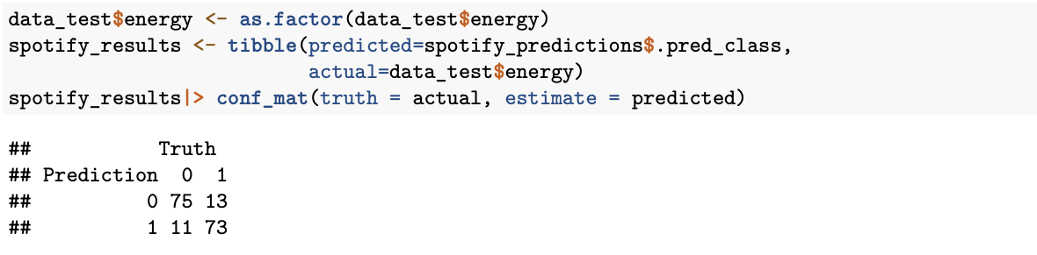

This output is called a confusion matrix, which is used to evaluate the performance of a classification model. The confusion matrix shows the relationships between the classes predicted by the model and the actual classes.

Slide 17
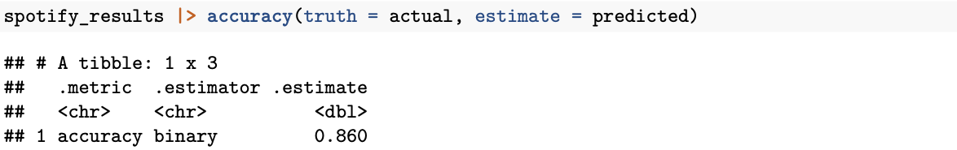

In line with this information, the accuracy metric of the model was calculated as 86.05%. This indicates that 86.05% of all predictions of the model were correct. The accuracy metric is used to evaluate the overall performance of the model and in this case we can say that the model performs quite well.

Slide 18
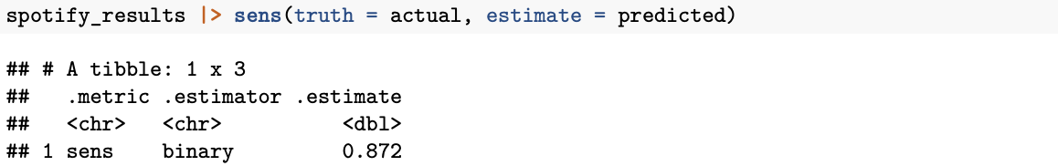
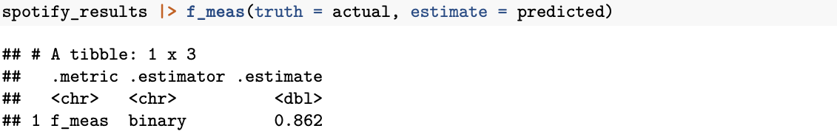
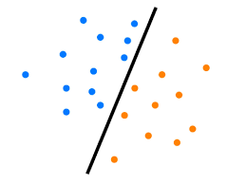
This result shows that the model can identify examples belonging to the positive class with 87.21% accuracy and does not miss them. This metric shows that the model performs quite well in terms of correctly detecting positive examples.
According to this table, the F1 score of the model is calculated as 86.21%. This shows that the model strikes a good balance between precision and recall values. The model is successful in correctly identifying positive classes and minimizing the number of false positives.

Slide 19
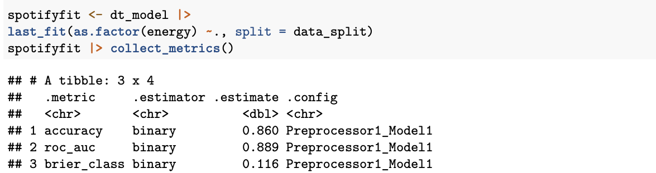
Overfitting Check for Decision Tree Model :
Accuracy: 86.05% of all predictions of the model are correct. This indicates that the overall performance of the model is good.
ROC AUC: ROC AUC score indicates that the classification ability of the model is good. The closer it is to 1, the better the model’s ability to distinguish positive and negative classes. This score indicates that the model performs quite well with 88.93%.
Brier Score: The Brier score measures how accurate the predicted probabilities are. A lower Brier score indicates better performance. In this case, a low score of 0.116 indicates that the model’s probability predictions are accurate.

Slide 20
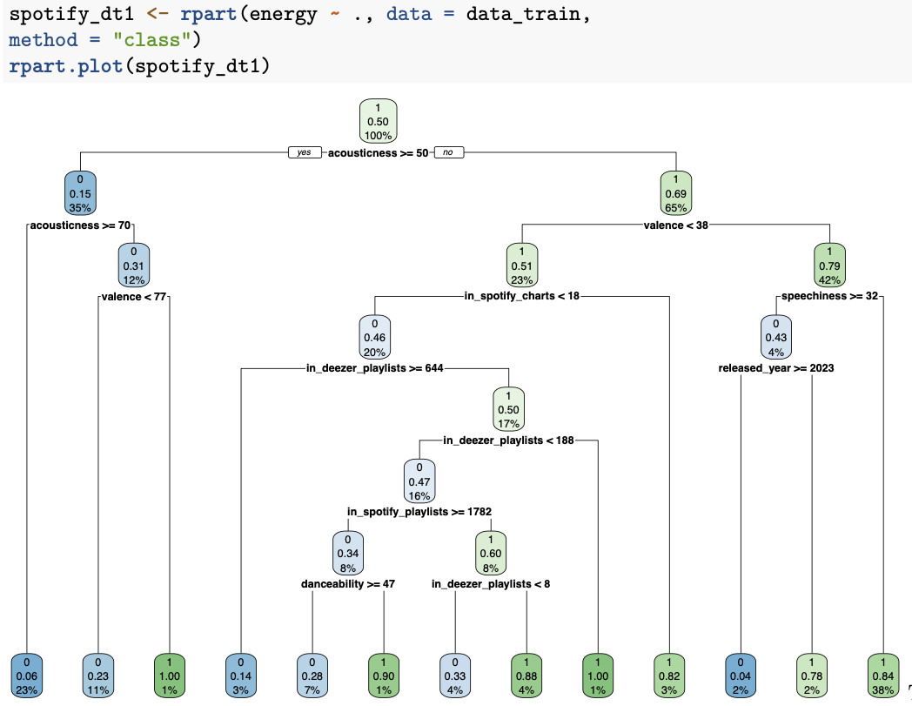
This decision tree uses features such as acoustics, valence, playlist appearances, conversation rate, and release year to predict the popularity of songs. Each leaf node represents the probability that songs belonging to that branch will become popular. In summary, this chart is a visual representation of a model used to predict whether songs will be popular based on musical characteristics.

Slide 21
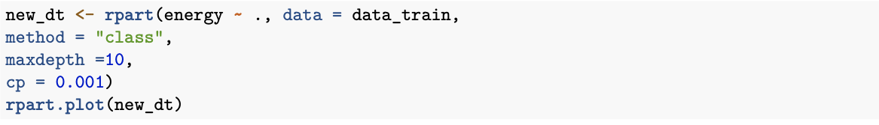
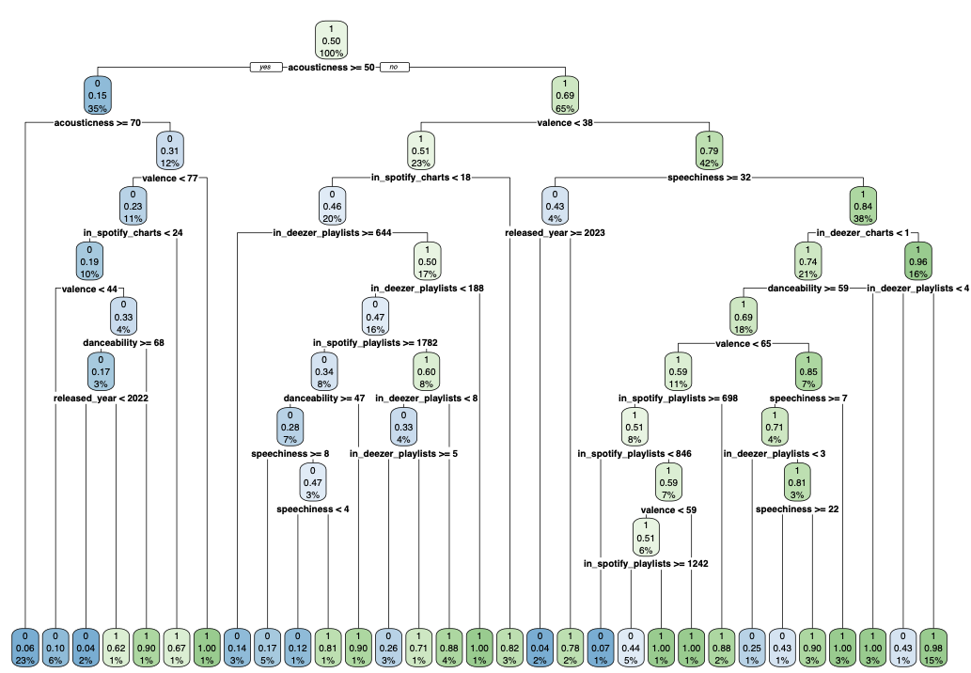
valence < 38: Songs with valence less than 38:
in_spotify_charts < 18: If Spotify charts have less than 18 songs (0.46%).
in_deezer_playlists <= 644: If there are 644 or fewer songs in Deezer playlists (0.47%).
in_spotify_playlists >= 1782: If Spotify playlists have 1782 or more songs (0.85%).
danceability <= 47: Danceability is less than 47 (0.38%).
speechiness <= 8: Speechlessness is less than 8 (0.47%).
in_deezer_playlists < 188: If there are less than 188 songs in Deezer playlists (0.50%).
valence >= 38: Songs with valence 38 or higher:
released_year >= 2023: Songs released in 2023 or newer (0.43%).
speechlessness >= 32: Speechlessness is 32 or higher (0.84%).
in_deezer_charts < 1: Songs that do not appear on Deezer charts at all (0.74%).
danceability <= 59: If danceability is less than 59 (0.95%).
speechiness <= 7: Speechlessness is less than 7 (0.81%).
in_deezer_playlists <= 1: If there is 1 or less song in Deezer playlists (%0.51).

Slide 22
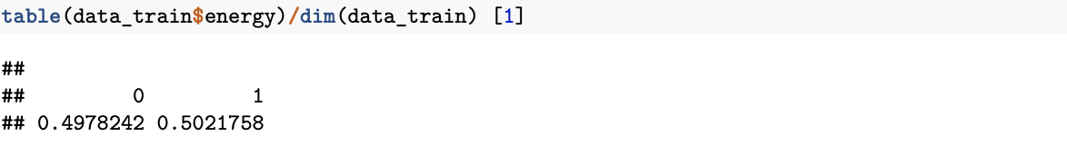

These results show that the class distribution of the energy variable in the data_train dataset is quite balanced. The proportions of both classes (0 and 1) in the dataset are approximately equal, which allows the model to have a more balanced performance in learning and predicting both classes. Balanced class distribution minimizes potential model performance problems that may arise from imbalance between classes.

Slide 23
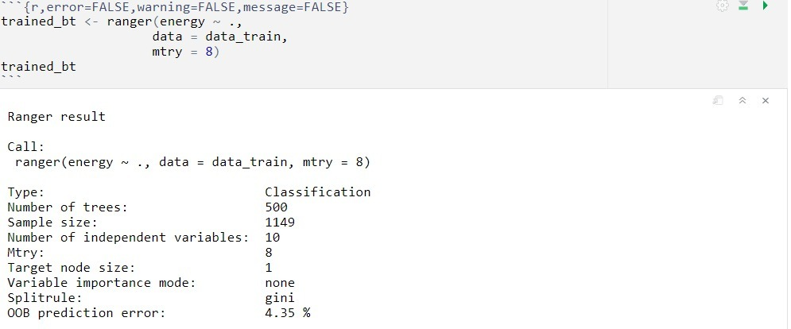
Bagging Tree Model and It’s Performance :
This output contains the summary of the training process of the bagging tree model. Here are some highlights from this output: Model type: A classification model was trained on the given data set. Number of trees: The model consists of a total of 500 trees. Sample size: There are 1149 samples in the training dataset. Number of independent variables: 10 independent variables were used in the model. Mtry: The number of independent variables that trees consider for randomly selected split points is determined as 8. Target node size: set to 1. Variable importance ranking mode: It is stated that the importance order of variables is not determined. Division rule: The “gini” division criterion was used when determining the division points of trees. OOB prediction error: Out-of-Bag (OOB) prediction error is reported as 4.35%. OOB error represents the error rate of predictions made on data points that were not used in training the trees. In this case, 4.35% indicates that approximately 4.35% of these predictions are incorrect.

Slide 24
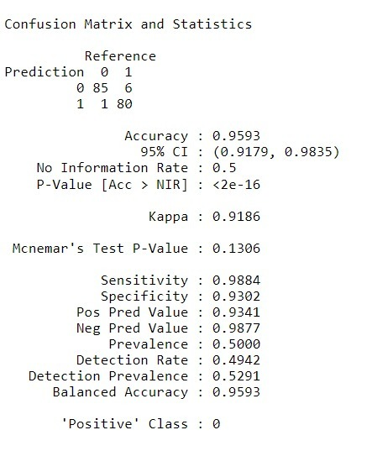

This output shows that the model has a high overall accuracy rate (0.9535), while the specificity value is slightly lower (0.9186) and the Kappa value is slightly lower (0.907).It can be said that the performance of the model is generally quite good and provides a good fit with the data.

Slide 25
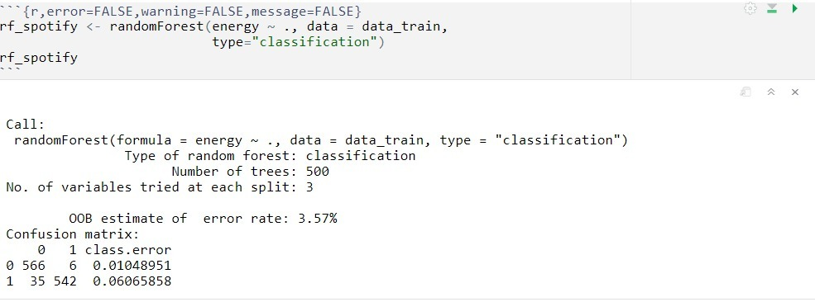
Random Forest Model and It’s Performance :
Number of trees: The model consists of a total of 500 trees. Number of variables tried at each division: It was stated that 3 variables were tested at each division point. OOB prediction error rate: Out-of-Bag (OOB) prediction error is reported as 3.57%. This is the error rate obtained by predicting a portion of the training data set without being used by each tree.
Confusion matrix: A matrix used to evaluate classification performance in more detail. This matrix allows comparison of actual classes with predicted classes. For example, it was stated that there were 566 correct guesses and 6 wrong guesses in class 0. It can be seen that there are 35 wrong guesses and 542 correct guesses in class 1.
Class error rates: Error rates are reported separately for each class. For example, the error rate for class 0 is 0.0104%, and for class 1 it is 0.0606%.
This output provides valuable information about the configuration and performance of the model. Since the OOB error rate is low, it can be said that the model generally performs well.

Slide 26
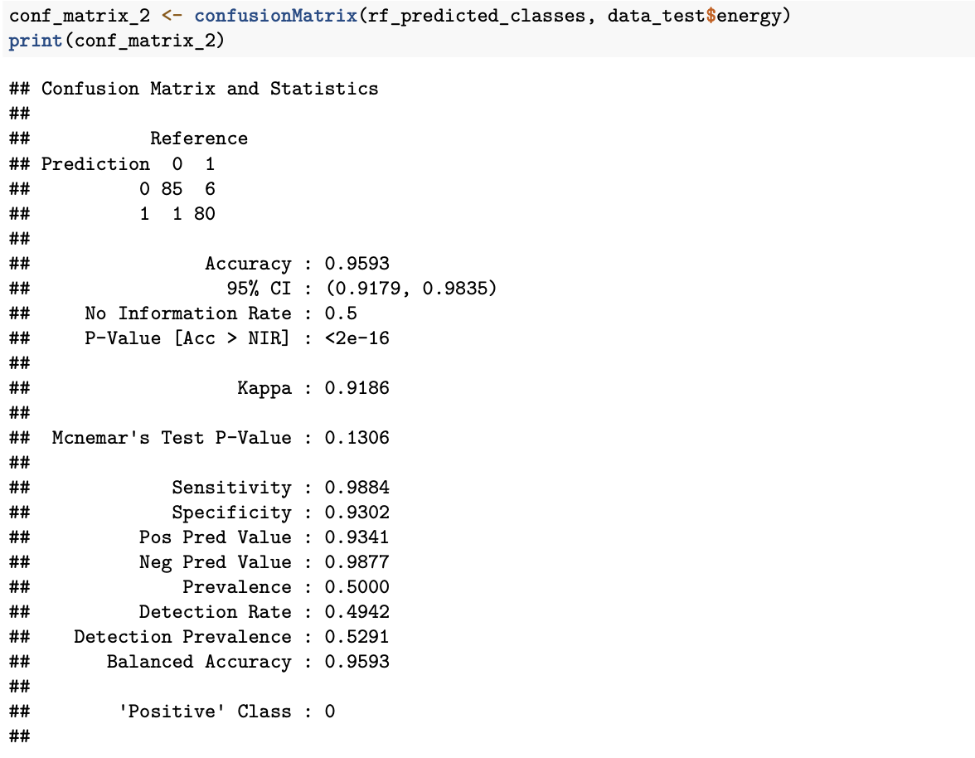
According to this output, the model shows a very high accuracy rate (0.9593) and a balanced sensitivity (0.9884) and specificity (0.9302). This indicates that the model performs well overall.

Slide 27




THANKS FOR LISTENING!

